Slide 1

Capstone Project - Azure Cloud Foundation Design
Group 1
Thanh Trung Nguyen
Anjali Kumari
Kanan Garach
Nitika Gupta

Slide 2
WHY CLOUD FOUNDATION DESIGN ?
Azure Scaffold
Uncontrolled and Ungoverned builds can lead to Cloud Sprawl
Costly cloud solutions
Resource
Hierarchy
Insecure and Ungoverned deployments
Consume resources from cloud and operate Independently .
No Central Management, Support Issues
Why Not ?
Limited by Subscription limits and resource quotas.
Overcoming Subscription Limits
Private
Connectivity
Reducing Billing & Management Overhead
CLOUD ADOPTION FRAMEWORK
This solution is based on providing a Foundation Landing Zone for cloud adoption and future migrations.
.
Why Yes ?
Cost Effectiveness – shared core services
Workloads isolation whilst sharing core services
Hub
Spoke
Model
Perimeter security, virtual network panning with Hub Spoke topology
Enabler for Cloud early adopters to consume cloud resources in a secure, supportable manner

Slide 3
FOUNDATION DESIGN PURPOSE
Helps to maintain Resource Hierarchy in terms of Management Groups, Subscriptions, Resource Groups, Virtual Networks and Subnets.
Azure Policies are applied at Management Group to enforce guardrails. E.g. – Enforce Naming Standards, Deny provisioning certain types of resources like Marketplace Images, Policies to deny direct RDP or SSH from Internet etc.
Based on best practices from the vendor for Cloud Adoption.
Policies applied at parent group cannot be overwritten, however child management group policies can be applied at Subscription level. E.g. – Storage naming convention for a certain business function.
RBAC is implemented to segregate roles and permissions between subscriptions. Custom Global Roles are created for central management, some roles are tightly secured to disallow role elevation, subscription level Roles are created to provide business functions some autonomy to provision resources.
Tagging implementation for Resource Management, Cost Management and Optimization, Operations Management, Governance & Compliance etc.
Hub-Spoke Network Topology where Hub is central, shared network zone controlling any ingress or egress traffic between different zones: Internet, On-Prem and Spokes. Spokes represent each network zone where Business workloads resides and run.

Slide 4
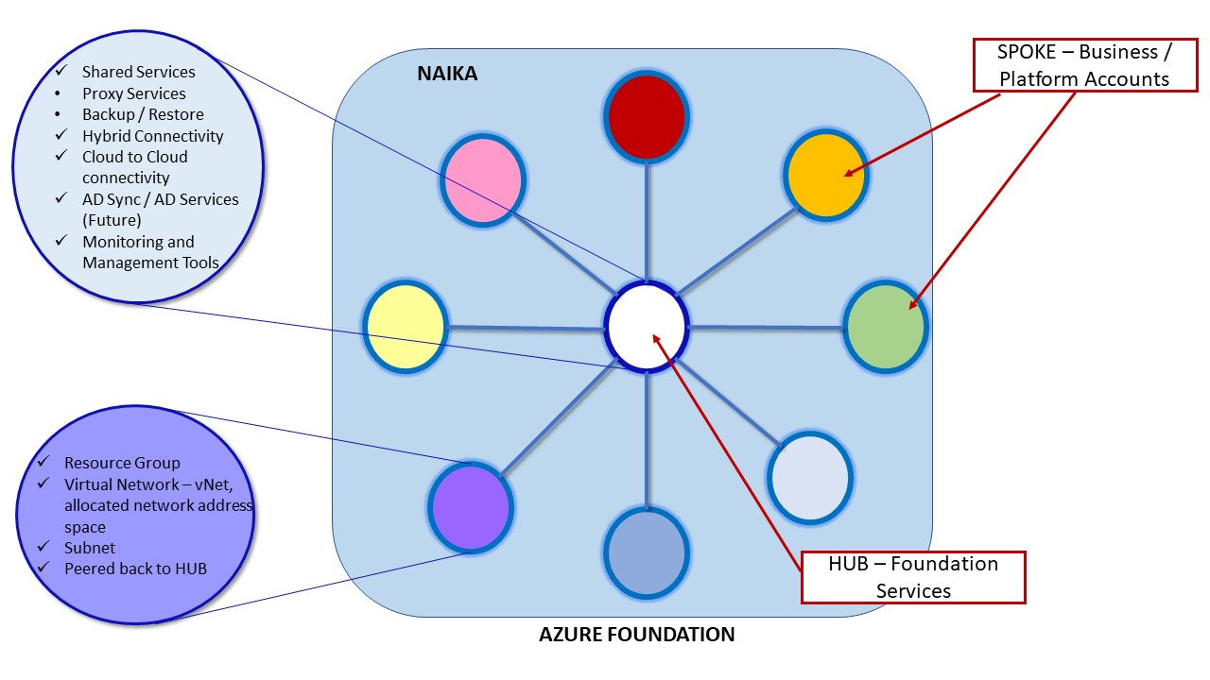
HUB SPOKE TOPOLOGY
Hub-and-Spoke Network topology is one the best practices from Microsoft under Cloud Adoption Framework for efficient and securely managing the communication.
Single Subscription
Single Account
Azure Services Used
Subscriptions
Resource Groups
vNets and Subnets
Network Security Groups
vNet Peering
vNet Endpoint
Private Link
Azure Firewall
Azure MySQL Database
DB Public and Private Access
Azure Virtual Machines
Azure Storage Containers
Private Endpoint
Azure accounts:
CapstoneAcc2@outlook.com
Domain Name: Capstoneacc2outlook.onmicrosoft.com
Syst8200Proj@outlook.com
Domain Name: Syst8200Projoutlook.onmicrosoft.com

Slide 5
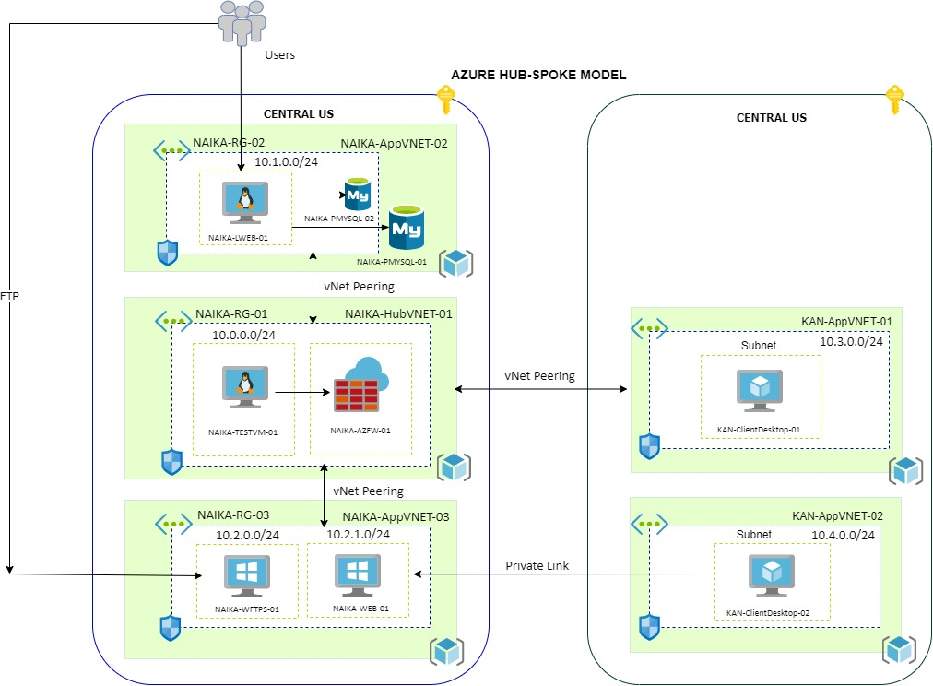
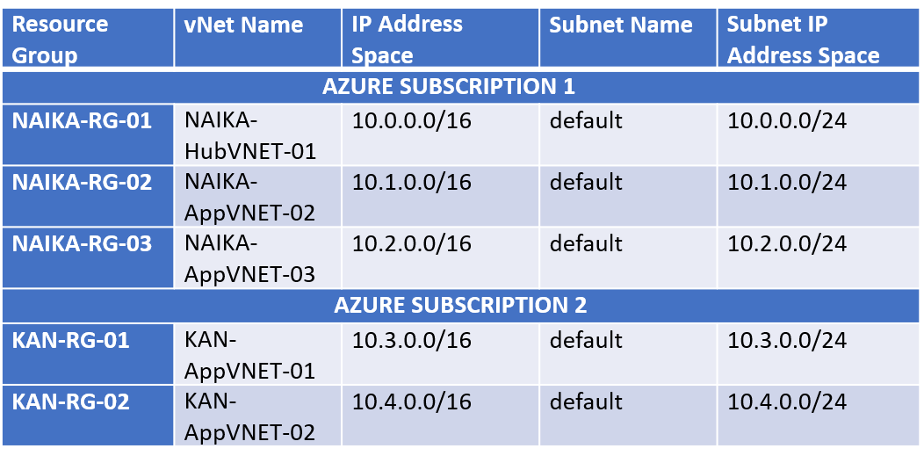
NETWORK TOPOLOGY &ARCHITECTURE

Slide 6
vNET PEERING PURPOSE
Traffic between two peered networks is routed through Microsoft backbone infrastructure.
Two ore more networks are directly peered, providing a low latency, high-bandwidth network with no extra hops or gateways.
vNet peering connects two Azure virtual networks for seamless connectivity.
vNet peering is non-transitive.
Use cases of vNet peering involve – Database replication, low latency replication, database failovers etc.
Peering can be done within same subscription or different subscriptions (Global and Cross AD)

Slide 7
vNET PEERING
PEERING BETWEEN HUB & SPOKE
PEERING BETWEEN TWO AD TENANTS
HUB vNET
SPOKE vNET
TENANT 1 vNET
TENANT 2 vNET
Peering is supported for non overlapping IP address space.
Bi-directional vNet peering is setup.
These vNet can be in single subscription or multiple subscriptions, one per subscription.
Network Contributor Role is required to make any changes at Network level.
Peered Networks:
HubVNET-01 - peered to – AppVNET-02
HubVNET-01 - peered to – AppVNET-03
AppVNET-02- peered to – HubVNET-01
AppVNET-03- peered to – HubVNET-01
Peering across AD tenants is unidirectional, so must be set from both accounts to be peered if bi-directional connectivity is required. Cross-AD vNet Peering requires authorization across the AD tenants.
Network Contributor Role is assigned to the accounts across the AD tenants with which peering is established.
This peering is secured through Azure Firewall
vNet Peering from NAIKA to KAN is setup as:
NAIKA-HubVNET-01 - peered to – KAN-AppVNET-02 ( Capstoneacc2 to Syst8200Proj )
vNet Peering from KAN to NAIKA is setup as:
KAN-AppVNET-02- peered to – NAIKA-HubVNET-01 (Syst8200Proj to Capstoneacc2 )

Slide 8
AZURE FIREWALL PURPOSE
Azure Firewall is a PaaS firewall service used to provide network traffic filtering
In the cloud, security is one of the largest growing concerns since it is widely exposed to the internet
This raises a significant issue when operating in the cloud since this presents a greater amount of threat vectors, especially when connecting to third party networks
Firewalls are an integral component of any IT infrastructure as it helps provide an extra layer of protection to the systems operating on the network

Slide 9
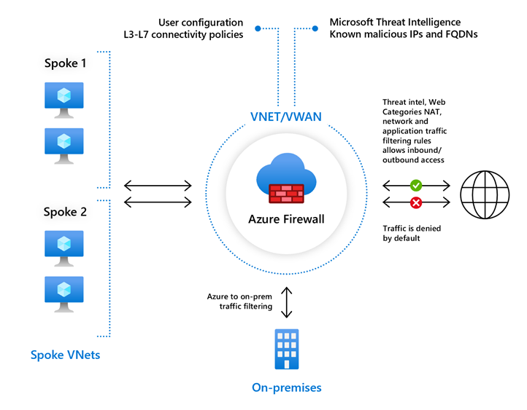
CONFIGURATION OF AZURE FIREWALL
Implemented network rules to specify traffic being filtered through the Azure Firewall
Remote Desktop protocol (3389) has been added to test connectivity through nested RDP
Created network route in Route Table specifying that traffic originating from KAN network to default subnet of NAIKA-HubVNET-01, must route through Azure Firewall (Virtual Appliance)
Associated default subnet on NAIKA-HubVNET-01 to the route created so that traffic filtering processes can be applied to the network

Slide 10
CLIENT DESKTOP PURPOSE
Each client desktop serves a different functionality in the environment related to testing components
NAIKA-TestVM1 – Used to test connectivity to the Azure MySQL Database and locally host web application
KAN-ClientDesktop-01 – Used to test and verify successful connection through firewall filtering
KAN-ClientDesktop-02 – Used for testing private link connectivity

Slide 11
CLIENT DESKTOP REQUIREMENTS
Established multiple vNets representing different departments where the various client desktops created will reside
Designated which applications would be installed on each of the client desktops operating in each environment

Slide 12
CONFIGURATION OF CLIENT DESKTOPS
Client desktops have been configured as Azure Virtual Machines
Three client desktops in total have been configured for use in the environment
First resides in NAIKA-RG-01, second in KAN-RG-01, and third in KAN-RG-02
Storage has been set to Standard HDD and Sizing has been set to 1vCPU with 3.5GB RAM
This has been done to avoid higher cost expenditures due to credit limitations
VMs created are running on the Windows 10 operating system (Pro version)

Slide 13
PRIVATE ENDPOINT PURPOSE
A Private Endpoint associates a private IP in the virtual network where the private endpoint is configured.
Azure PaaS Services like storage, databases and WebApp can be accessed over private network using private endpoint.
This traffics traverses over Microsoft backbone network and not over public network.
Multiple private endpoints can be created on the same or different subnets within the same virtual network to connect to different services.
The connection is secure as enabling private endpoint disables public access by default.

Slide 14
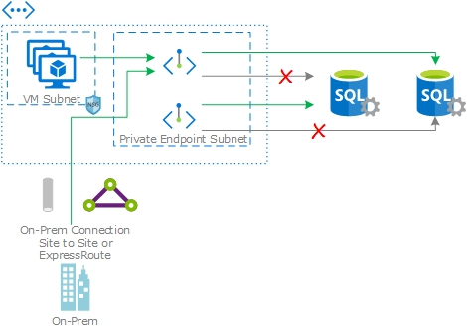
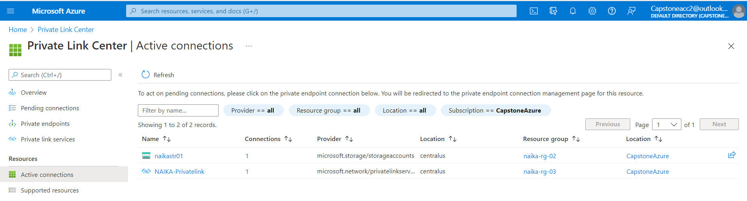
PRIVATE ENDPOINT
The private endpoint must be deployed in the same region and subscription as the virtual network.
A private endpoint cannot be deployed in a subnet with Service endpoint enabled.
In our project, a storage container is created with private endpoint enabled.
In KAN – a Private endpoint is created using private link. This is created to access a service published via private link service. Hence, there are two active private connections in NAIKA network.
https://www.nblabs.net/img/Private-Link2.jpg

Slide 15
PRIVATE LINK PURPOSE
Private Link is used to integrate PaaS and Partner hosted services into your private virtual network by mapping it to a private endpoint. Private Link Service s the reference to your own service supported by Azure Private Link.
This traffics traverses over Microsoft backbone network and does not require to be exposed to Internet.
Private link is one of the most secure ways to provide connectivity wherever data regulations and compliance requirements are of highest level.
Private endpoint is required for private link and should be deployed in the same subscription and network where the provider resource is.
Network connections are unidirectional and can only be initiated by clients that are connecting to private endpoint.
Two networks with over-lapping IP address range can be connected using Private Link.

Slide 16
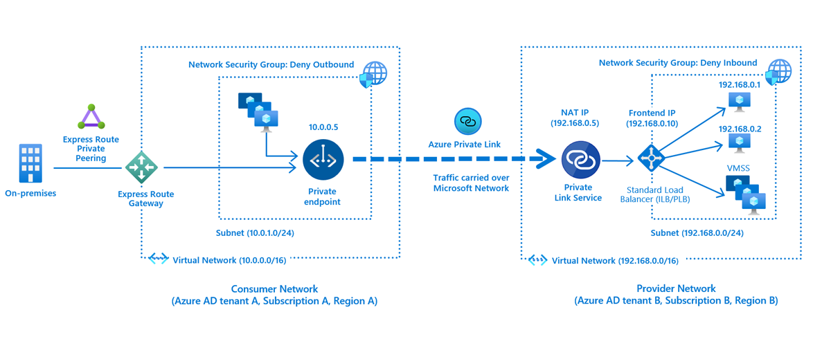
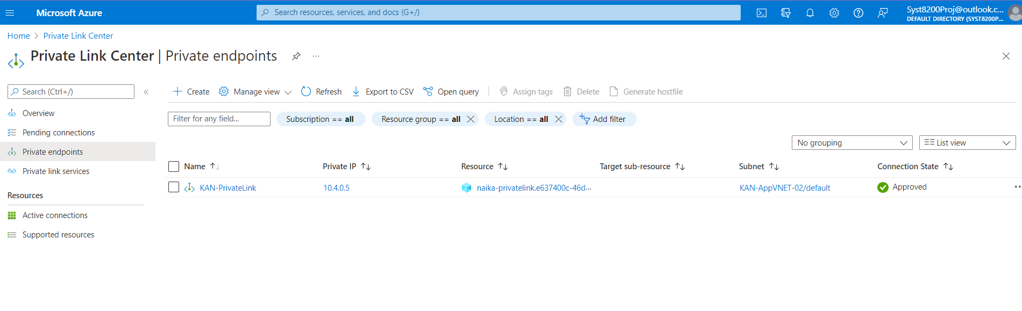
PRIVATE LINK
We are demonstrating use of private link with two different AD tenants in this project.
Azure Private link service diagram is taken from MS website.
In our project, NAIKA is the provider network and KAN is the consumer network.
In NAIKA - A test web service is created on a Windows 10 VM. This service runs behind an internal standard balancer. A Private link service is created which requires a NAT IP. This NAT IP is to shadow the back-end IPs.
In KAN – a Private endpoint is created using private link. This will require the alias or Resource ID of Private link service created in NAIKA network. Once the connection is created, it must be manually approved from NAIKA network. After approval, the connection status changes to Active.
https://docs.microsoft.com/en-us/azure/private-link/media/private-link-service-overview/consumer-provider-endpoint.png

Slide 17
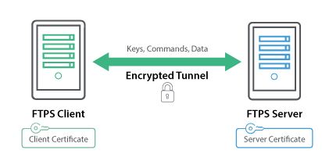
FTP SERVER - PURPOSE
This component in the solution is used in order to transfer between Client & Server over TCP/IP with the default port is 21.
In our solution, the FTP Site get the external IP address and the port range. The machine Firewall and the NSG define the rule to allow the client connect to the server based on the rule that define these components.
Using WinSCP to establish the connection to the site and conduct testing by transferring some files.
It supposed to have the FTP server connect to the VM Test 2 on KAN network via the Private Link.

Slide 18
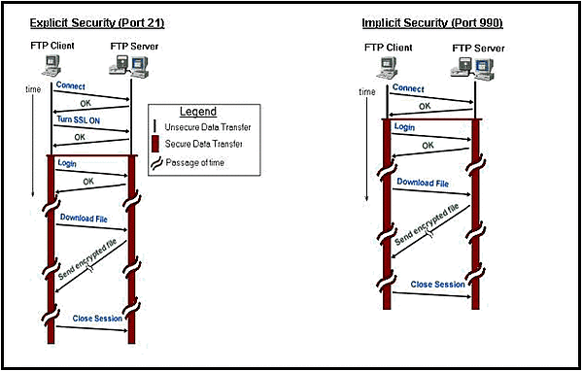
FTPS SERVER CONFIGURATION
The FTP Server machine is running in Window Server 2019 in NAIKA-Group3.
Create FTP Site with the Firewall Configuration that allow to connect to Server via Public IP address that associate with the virtual machine.
Set the Firewall rules from the machine to allow FTP port 21 works on this machine.
Create the self-certificate to change it to FTPS connection. It requires explicit certificate if we want to establish connection from the client machine.
Set the rules in the NSG to allow FTP port connect forward and backward between FTP Server.

Slide 19
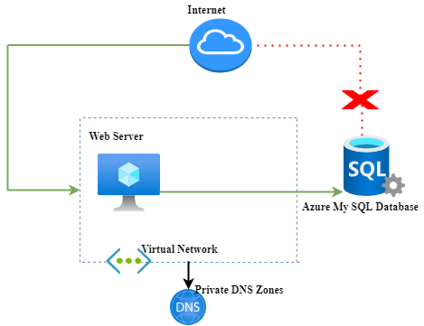
AZURE MySQL DATABASE SERVER
Using the fully managed Azure My SQL database service created the private and public database, demonstrating the integration between the web server and database server.
Naika-pmsql-02 is database which can be accessed only by the 10.0.0.0/24 network, it is restricted from the public access(via interNaika-pysql-02 is database which can be accessed only by the 10.0.0.0/24 network, it is restricted from the public access(via internet). We have implemented the private access for this database to provide the secure access on the database. Whereas the naika-pmsql-01 My SQL Azure database can be access publicly from the internet.
We have implemented both the private and public database to demonstrating the difference between private and public access.
In order to manage our database, we have installed the My SQL workbench and use the fully qualified domain and server admin name and default port 3306 to connect the My SQL azure database with the My SQL workbench. Once the database is imported successfully , we can add , update and delete the records and verify them successfully on the application as well.

Slide 20
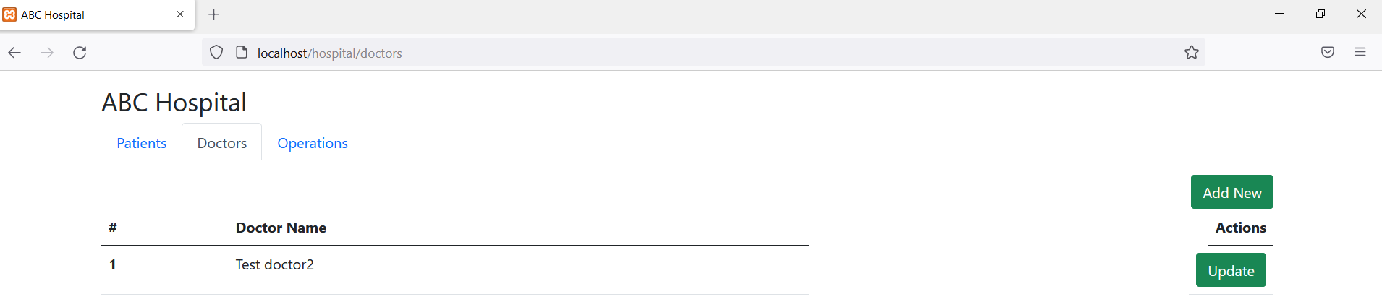
WEB SERVER
To host our web application in the Azure cloud created the web server.
Configure the Apache server on the web server, installed the XAMPP, start the My SQL and Apache service.
Once the integration between the database and application. Launch the browser and access the url: http://localhost/hospital ,which will launch the application.

Slide 21
CHALLENGES FACED & RESOLVED
Limited to $200 USD in Azure credits.
Limitation on
Azure Region
Not all Azure Regions provide VMs and PaaS resources in free tier. Had to redeploy network resources in different regions to identify the most suitable one.
Limit on free tier resources
RESOLUTION PATH
Free Tier Subscription – 30 days Limit
Project level Challenges
Free Credits limit
Only one subscription
Azure Account
Management
Identifying suitable Azure Region
Diligent Cost Management
Default Subscription
Limitation on Azure Credits
Only one subscription is allowed in free tier account and default subscription name is Azure Subscription 1
Free Azure account is limited to $200 USD worth of credits.
Azure Accounts
Free Account Limitation
Microsoft limits number of free accounts available to each user account. We were limited by this constraint as all of us had created multiple Azure accounts in the past.

Slide 22
KEY PROJECT FACTORS
Limited to $200 USD in Azure credits.
Limitation on
Add Text
Add Text
Add Text
Add Text
Add Text

